Slide 1

Investigating the effectiveness of Machine Learning in Cybersecurity and how it defends against Data Mining

Slide 2
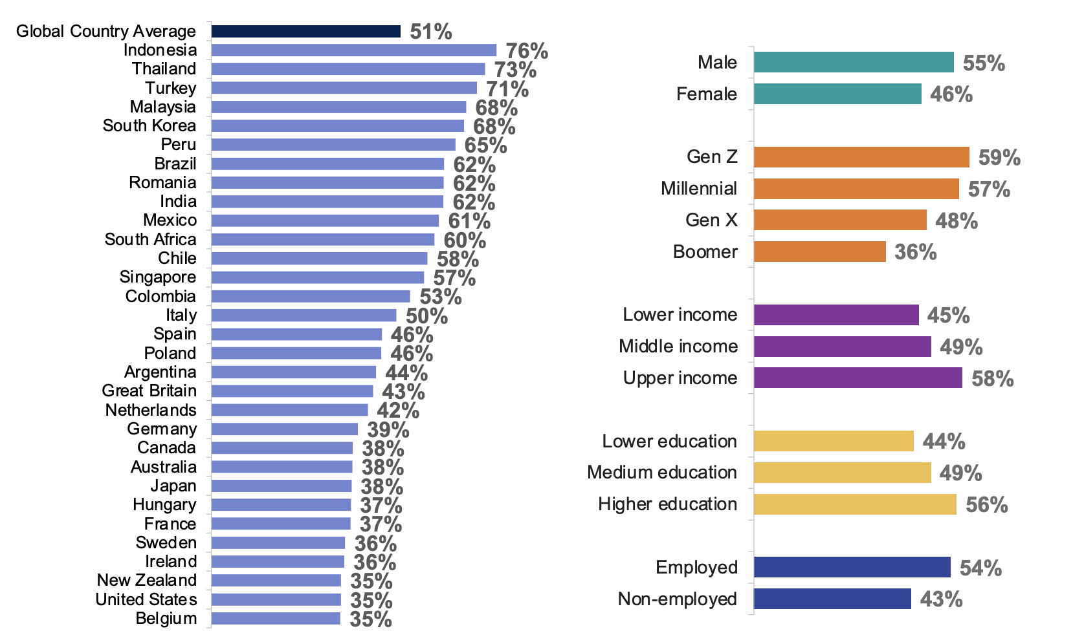
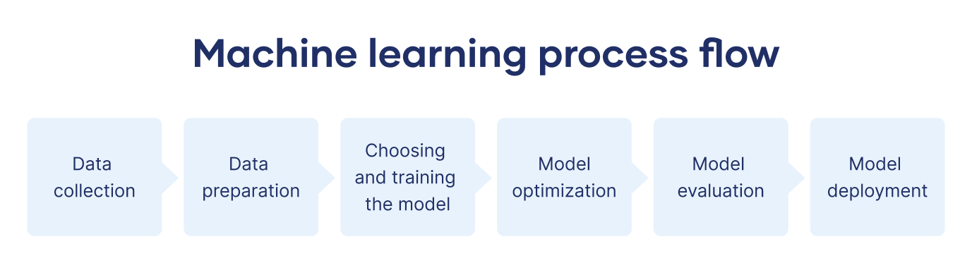
Machine learning and its uses
Machine Learning (ML) is a subset of AI and is coded to function similarly to the human brain. Initially, it is inefficient and makes a lot of mistakes, but over time it becomes more accurate.
(Hosch, 2024)
Machine Learning is used for many various tasks. A few examples include:
Biometric Systems
Product Recommendations
Cyber Security
(Cipriani, 2020), (NVIDIA, 2021)
Figure 1: Global Understanding of AI and Machine Learning
(Ipsos, 2023)
Cipriani, J. (2020) iPhone Face ID is pretty cool. Here's how it works and how to use it. Available at: https://www.cnet.com/tech/services-and-software/the-iphone-and-ipads-face-id-tech-is-pretty-darn-cool-heres-how-it-works-and-how-to-use-it/ (Accessed: 23 October 2024).
Hosch, W. (2024) Machine learning, Encyclopædia Britannica. Available at: https://www.britannica.com/technology/machine-learning (Accessed: 25 September 2024).
Ipsos (2023) Global Views on AI 2023. Available at: https://www.ipsos.com/sites/default/files/ct/news/documents/2023-07/Ipsos%20Global%20AI%202023%20Report-WEB_0.pdf (Accessed: 31 October 2024).
NVIDIA (2021) What is a Recommendation System?. Available at: https://www.nvidia.com/en-gb/glossary/recommendation-system/ (Accessed: 23 October 2024).

Slide 3

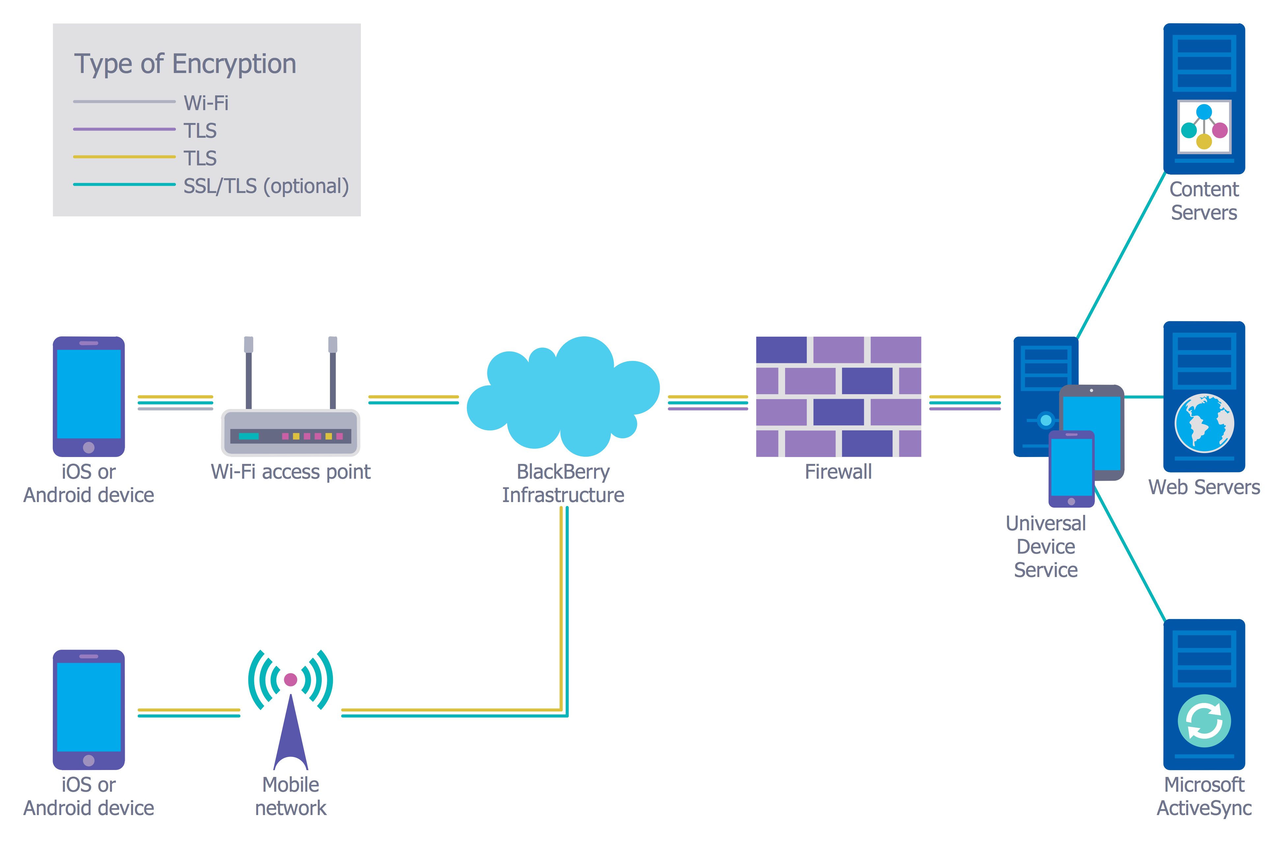
Cybersecurity and machine learning
Cybersecurity is the process of lowering the risk of cyber-attacks and defending against potential attacks through different methods:
Firewalls
Intrusion Monitoring
Encryption
(NCSC, 2016)
Machine Learning is used to “identify and respond to security incidents” (IBM, 2024), as well as to analyse data for potential patterns (Cisco, 2023).
Figure 2: Web-attacks globally 24/10/2024 at 13:37
(Radware, 2016)
Cisco (2023) What Is Machine Learning in Security?. Available at: https://www.cisco.com/c/en/us/products/security/machine-learning-security.html (Accessed: 23 October 2024).
IBM (2024) Artificial Intelligence (AI) Cybersecurity | IBM. Available at: https://www.ibm.com/ai-cybersecurity?utm_content=SRCWW&p1=Search&p4=43700068027042819&p5=e&p9=58700007551028510&gad_source=1&gclid=Cj0KCQjwveK4BhD4ARIsAKy6pMLBcK7bA_Y_OJAojGYAgpCsjr_UOBgOzUkrfUNP6VB8x-cU9UATi2waAlhaEALw_wcB&gclsrc=aw.ds (Accessed: 23 October 2024).
NCSC (2016) What is cyber security?. Available at: https://www.ncsc.gov.uk/section/about-ncsc/what-is-cyber-security (Accessed: 23 October 2024).
Radware (2016) Live cyber attack threat map. Available at: https://livethreatmap.radware.com/ (Accessed: 24 October 2024).

Slide 4
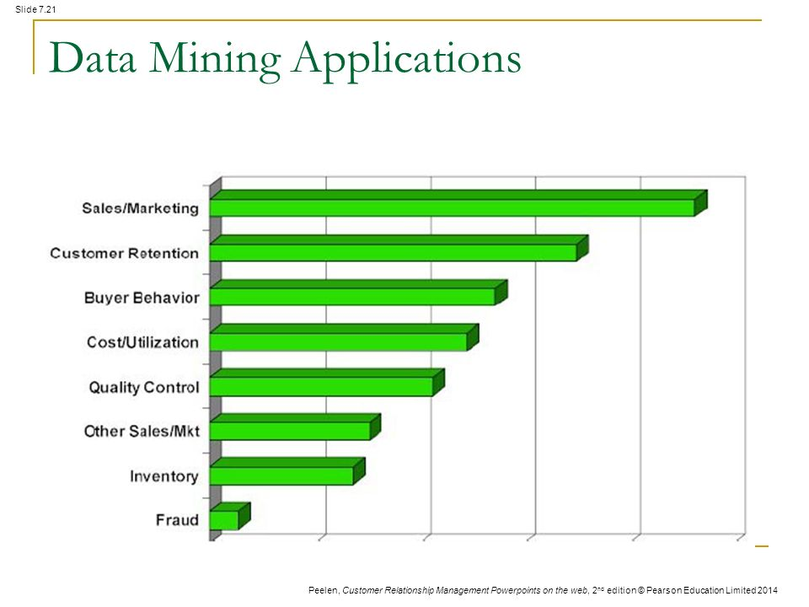
Data mining and cybersecurity
Data Mining is a process by which data is analysed for patterns and links within large data sets. Its versatile nature can prove highly beneficial in business (Sales, Marketing and IT), scientific research and criminal detection.
(Holdsworth, 2024)
Despite being invaluable for organisations, cybercriminals also use Data Mining. Cybercriminals use Data Mining to:
Scan networks automatically for specific data to steal
Access client information to scam them more effectively
(Smith, 2009)
Figure 3: 8 Most Common Applications of Data Mining
(Munasinghe, 2017)
Holdsworth, J. (2024) What is Data Mining?. Available at: https://www.ibm.com/topics/data-mining (Accessed: 24 October 2024).
Munasinghe, S. (2017) Data Mining in Brief. Available at: https://towardsdatascience.com/data-mining-in-brief-26483437f178 (Accessed: 31 October 2024).
Smith, G. (2009) 'Data mining: How hackers steal sensitive electronic information', Journal of Corporate Accounting & Finance, Volume 20 Issue 4. Available at: https://onlinelibrary.wiley.com/doi/abs/10.1002/jcaf.20496

Slide 5
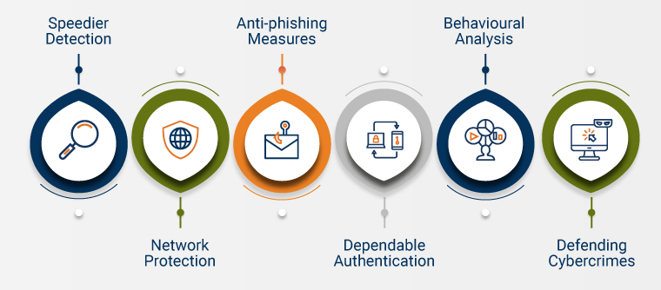
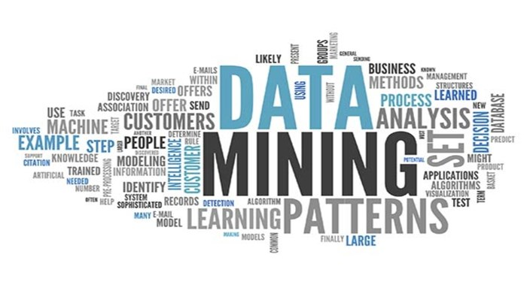
How machine learning defends against data mining
Data Mining is most often used for corporate purposes however, cybercriminals will use it nefariously. Companies have been forced to use Machine Learning to defend against these cybercriminals.
Since Machine Learning and Data Mining are “complementary in nature”, it allows for Machine Learning technologies to develop “highly predictive models” to anticipate where the cybercriminals will strike.
(Shams, 2023)
Figure 4: Ways Machine Learning defends against Data Mining
(Chahal, 2023)
Chahal, S. (2023) AI-Enhanced Cyber Incident Response and Recovery. Available at: https://www.semanticscholar.org/paper/AI-Enhanced-Cyber-Incident-Response-and-Recovery-Chahal/f49ed239ff4fd5f14da9c01a4f26ba58d649404d (Accessed: 31 October 2024).
Shams, A.M. (2023) The relationship between machine learning and Data Mining </fullexplain>. Available at: https://medium.com/@AmirMohammadShams/the-relationship-between-machine-learning-and-data-mining-fullexplain-fbc2d35db6eb (Accessed: 25 October 2024).

